Slide 1
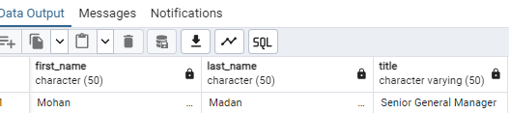
Queries With Output
Q1. Who is the senior most employee based on the job title?
Query :
select * from employee
order by levels des
limit 1

Slide 2
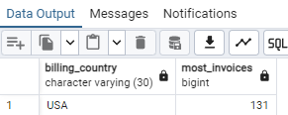
Q2. Which country has the most invoices?
Query :
select billing_country, count(total) most_invoices from invoice
group by 1
order by 2 desc
limit 1

Slide 3
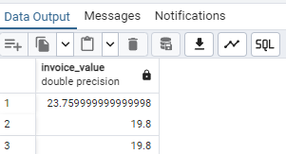
Q3. What are the top 3 values of the total invoice?
Query :
select total as invoice_value from invoice order by 1 desc
limit 3

Slide 4
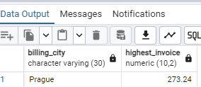
Q4. Which city has the greatest number of customers? We would like to throw a promotional Music Festival in the city we made the most money from.
Query :
select billing_city, cast(sum(total) as decimal (10,2)) highest_invoice from invoice
group by 1
order by highest_invoice desc
limit 1

Slide 5
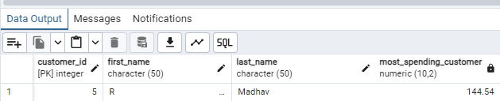
Q5. who is the best customer? The customer who has spent the most money will be declared the best customer.
Query :
select customer.customer_id, first_name, last_name, cast(sum(total) as decimal (10,2)) as most_spending_customer from customer
join invoice on customer.customer_id = invoice.customer_id
group by 1,2,3
order by most_spending_customer desc
limit 1

Slide 6
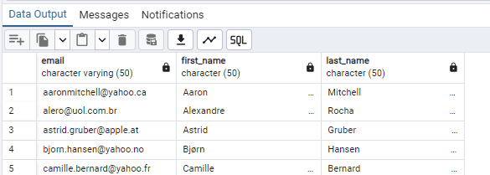
Q6. Write a query to return the email, first name, last name, and genre of all Rock Music listeners. Return the list ordered alphabatically with email starting with “ A ”
Query :
select distinct email, first_name, last_name from customer join invoice
on customer.customer_id = invoice.customer_id
Join invoice_line
on invoice.invoice_id = invoice_line.invoice_id
where track_id in (select track_id from trackjoin genre on track.genre_id = genre.genre_id
where genre.name like 'Rock’ )
order by email;

Slide 7
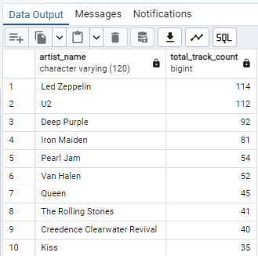
Q7. Let's invite the artists who have written the most rock music in our dataset. write a query that returns the artist names and total track count of the top 10 bands
Query :
select artist.name as artist_name, count(track.name) total_track_count from artist
join album on
artist.artist_id = album.artist_id
join track
on album.album_id = track.album_id
join genre
on track.genre_id = genre.genre_id
where genre.name like 'Rock’
group by 1
order by total_track_count desc
limit 10

Slide 8
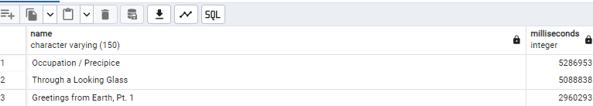
Q8. return all the track names that have a song length longer than the average song length. return the name and milliseconds for each track ordered by the song length with the longest songs listed first.
Query :
select name, milliseconds from track
where milliseconds > ( select avg(milliseconds) as avg_track_record from track)
order by milliseconds desc;

Slide 9
Q9. find how much amount has been spent by each customer on an artist to be a best-selling-artist
Query :
with best_selling_artist as
(select artist.artist_id as artist_id, artist.name as artist_name, sum(invoice_line.unit_price * invoice_line.quantity) as total_sales from invoice_line
join track
on track.track_id = invoice_line.track_id
join album
on album.album_id = track.album_id
join artist
on artist.artist_id = album.artist_id
group by 1,2
order by 3 desc
limit 1)
select c.customer_id, c.first_name, c.last_name, bsa.artist_name, sum(il.unit_price * il.quantity) as amount_spent from invoice I
join customer c on
c.customer_id = i.customer_idjoin invoice_line il on il.invoice_id = i.invoice_id
join track t on t.track_id = il.track_id
join album alb on alb.album_id = t.album_idjoin best_selling_artist bsa on bsa.artist_id = alb.artist_id
group by 1,2,3,4
order by 5 desc;

Slide 10
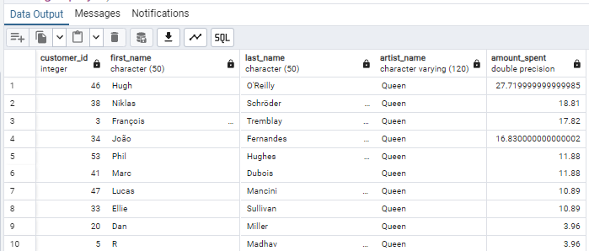
Output of Q 9.

Slide 11
Q10. we want to find out the most popular music genre for each country. we determine the most popular genre as the genre with the highest amount of purcahses. write a query that returns each country along with the top Genre.
Query :
with popular_genre as
( select count(invoice_line.quantity) as purchases, customer.country, genre.name, genre.genre_id, row_number () over (partition by customer.country order by count(invoice_line.quantity)desc) as RowNo
from invoice join customer on customer.customer_id = invoice.customer_id join invoice_line on invoice.invoice_id = invoice_line.invoice_id
join track on track.track_id = invoice_line.track_id
Join genre on genre.genre_id = track.genre_id
group by 2,3,4
order by 2 asc, 1 desc)
select * from popular_genre
where RowNo <= 1

Slide 12
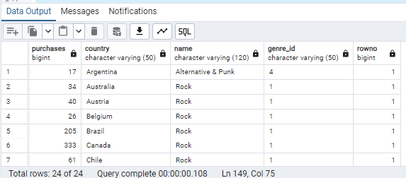

Slide 13
Q11. write a query that determines the customer that has spent the most on music for each country. write a query that returns the country along with the top spending customers and how much they spent.
Query:
with most_spending_customer as
(select customer.customer_id, first_name, last_name, country, sum(total)total_spending,row_number() over (partition by country order by sum(total)desc) as RowNo from customer join invoice on customer.customer_id = invoice.customer_id group by 1,2,3,4
order by 4, 5 desc)
select * from most_spending_customer
where RowNo <= 1

Slide 14
